Slide 1
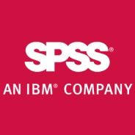

Интеллектуальный анализ данных
Data Mining
Predictive Analytics
Knowledge Discovery in Databases
Machine Learning
Notes:
Следующий этап анализа данных

Slide 2

Что такое интеллектуальный анализ данных?

Slide 3
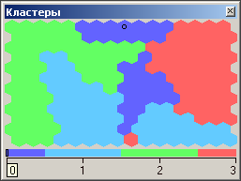
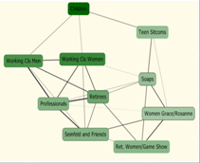
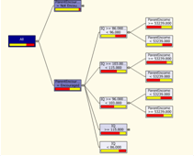
Что такое интеллектуальный анализ данных?
Data Mining – технология анализа информации с целью нахождения в накопленных данных ранее неизвестных, нетривиальных и практически полезных знаний, необходимых для принятия оптимальных решений в различных областях человеческой деятельности.
Данные -> Знания -> Действия -> Ценность

Slide 4
Типы задач, которые решает Data Mining
Описательный анализ – новые знания о бизнес проблеме
  Какова структура клиентской базы?
  Какие факторы влияют на уход клиентов?
  Какие события происходят совместно?
  Какие события происходят последовательно?
Предиктивный анализ – позволяет прогнозировать события
  Какова склонность клиента к покупке конкретного продукта?
  Какова вероятность возврата кредита?
  Какие клиенты собираются уйти в течение ближайших 3 месяцев?
  Какой объем продаж будет в следующем месяце?

Slide 5
На какие вопросы отвечает Data Mining?

Slide 6
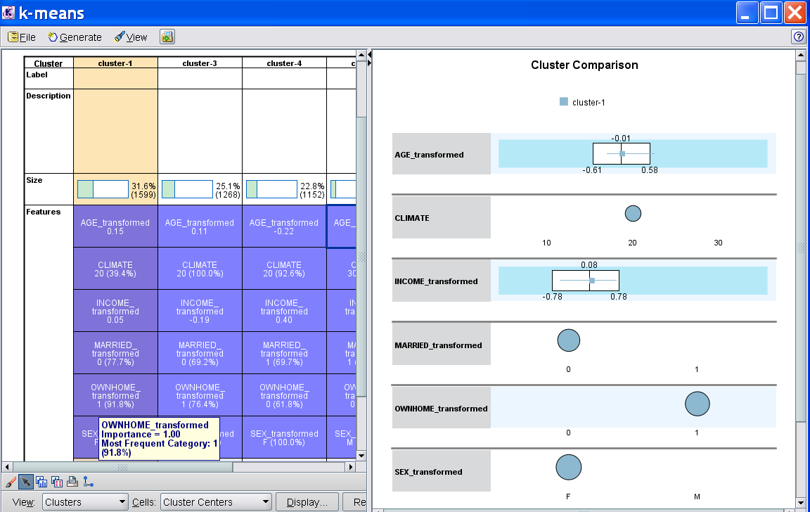
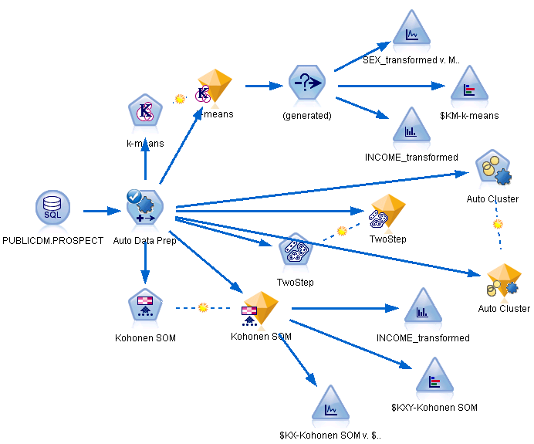
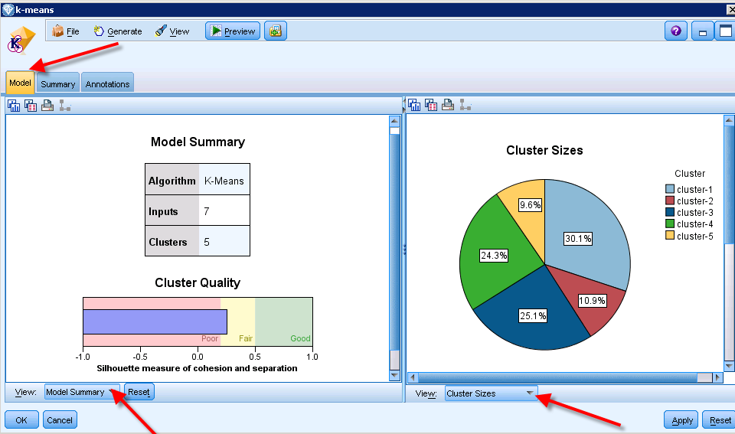
На какие вопросы отвечает Data Mining?
Кластеризация – обнаружение структуры в данных
На какие группы можно разбить клиентов?
Какая структура у заказов продажи?
Notes:
Ростелеком

Slide 7
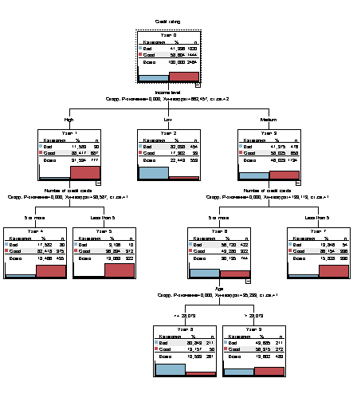

На какие вопросы отвечает Data Mining?
Классификация
Откликнется ли клиент с данными характеристиками на наше предложение?
Как отличить письмо-спам от «нормального» письма?
Как ведет себя клиент, собирающийся отказаться от услуг нашей компании?
Что влияет на вероятность оттока? Какие факторы влияют на кредитный рейтинг?

Slide 8
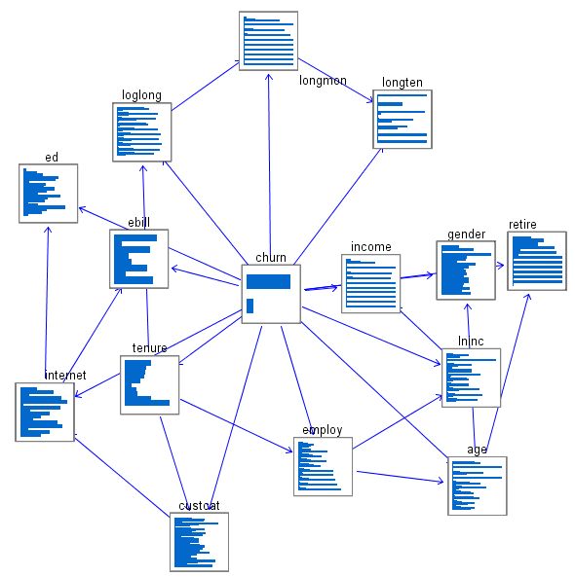
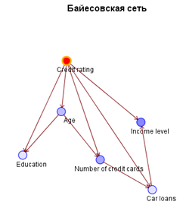
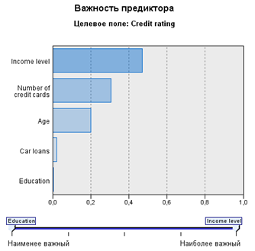
Алгоритмы – классификация и регрессия
Факторный анализ
Какие цепочки факторов влияют на целевую переменную. Какие факторы влияют напрямую, а какие – опосредовано?

Slide 9
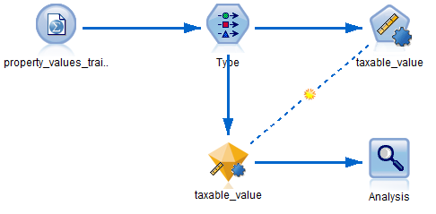
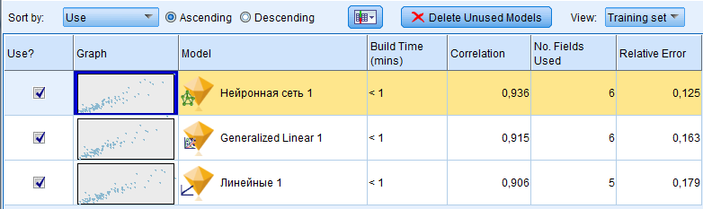
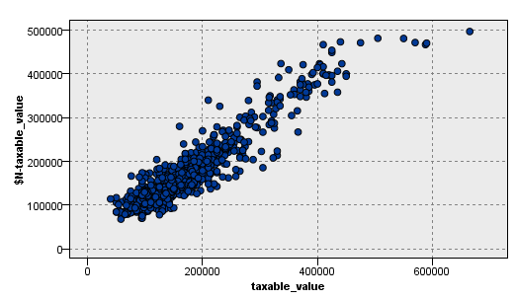
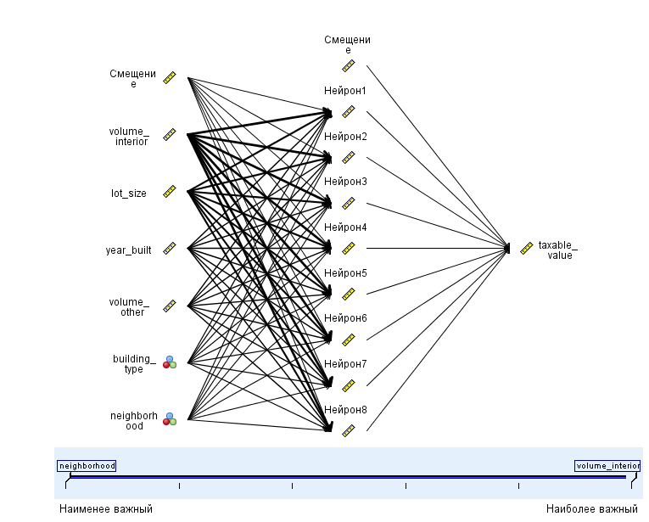
На какие вопросы отвечает Data Mining?
Регрессия
  Оценка риска невозврата банковского кредита в зависимости от социально-демографических, транзакционных характеристик физ. лица., а также макроэкономических факторов.
Прогноз стоимости жилья как функция от ряда факторов

Slide 10
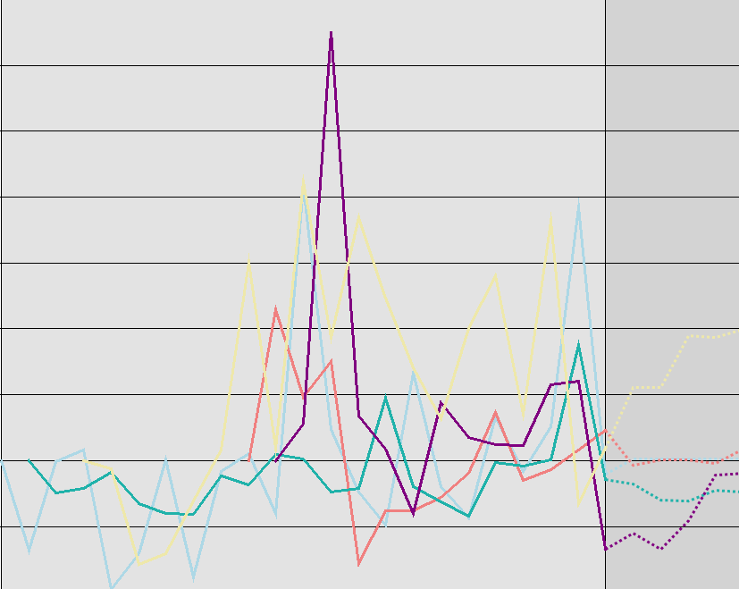
На какие вопросы отвечает Data Mining?
Прогнозирование временных рядов
  Прогнозирование продаж на будущий месяц на основании исторических данных.
Прогноз продаж товаров по категориям

Slide 11
На какие вопросы отвечает Data Mining?
Прогнозирование времени до события
Анализ дожития (survival). Динамика вероятности того, что клиент останется в течение следующего периода.
  Все клиенты смещаются по временной оси X в точку 0. По оси Y откладывается часть клиентов, оставшихся к этому времени.
Анализ опасности (hazard). Динамика вероятности ухода в следующем периоде при условии, что клиент остался до текущего.
      Все клиенты смещаются по временной оси X в точку 0. По оси Y откладывается часть оставшихся к этому времени клиентов, ушедших в следующем периоде.

Slide 12
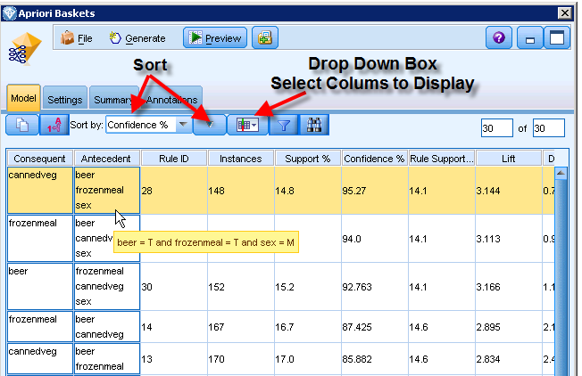
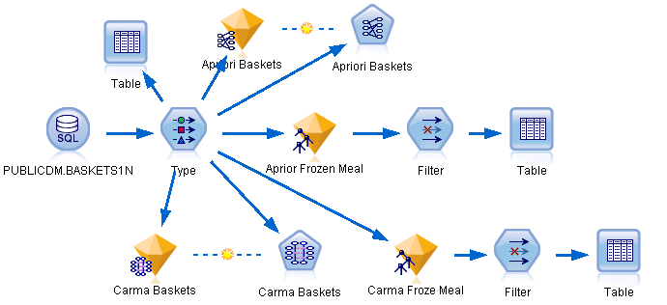
На какие вопросы отвечает Data Mining?
Ассоциации
  Какие товары продаются совместно?
Совместное появление каких симптомов ведет к поломке оборудования?

Slide 13
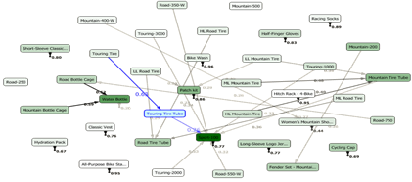
На какие вопросы отвечает Data Mining?
Анализ последовательностей событий
  Какие покупки ожидать в следующем месяце от человека, купившего в этом месяце планшет?
  С какой вероятностью человек, уменьшивший интенсивность звонков в три раза откажется в течение трех месяцев от наших услуг?
Временные шаблоны покупок велосипедных аксессуаров
Notes:
Web Analysis – web приложение

Slide 14
IBM SPSS Predictive Analytics

Slide 15





















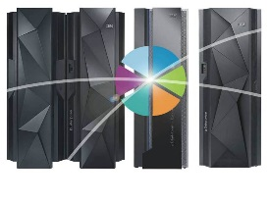


IBM SPSS Predictive Analytics Foundation
Predictive Maintenance and
Quality (PMQ)
Predictive Customer Intelligence (PCI)
Counter Fraud Management (CFM)
Custom Applications
Differentiated Analytic Solutions
Data Collection
Statistics
Modeler and ADM
Analytic
Server
Decision Optimization
Watson Analytics
Collaboration and Deployment Services
Notes:
Now let’s focus our attention on IBM’s platform for advanced analytics – which is a set of integrated capabilities that are part of the IBM SPSS portfolio
This powerful analytical foundation provides the predictive engine that drives Watson – but is also a core component of analytical solutions – some of which have been packaged, and others that can be configured to suite the need of any organization that has data.
The products here provide the following capabilities:
Data Collection – for creating powerful surveys that people want to complete, capturing the opinions, preferences and attitudes of people that is often not available through any other means
Statistics – for ad-hoc data analysis and data preparation
Modeler (with Analytic Decision Management) – for creating repeatable, deployed predictive analytics
Analytic Server – for taking predictive power to Big Data
Decision Optimization – for finding the best decision when faced with complexity of choice
..and Watson Analytics which, while not an integrated part of the predictive foundation, is a gateway for many users and has a rich predictive heritage expressed in its data visualization capabilities
..and the glue of Collaboraiton and Deployment Services that can tie these capabilities together and further connect them to the broader IBM ecosystem
Now…for those not familiar with the porfolio, let’s dive deeper into the key products.

Slide 16
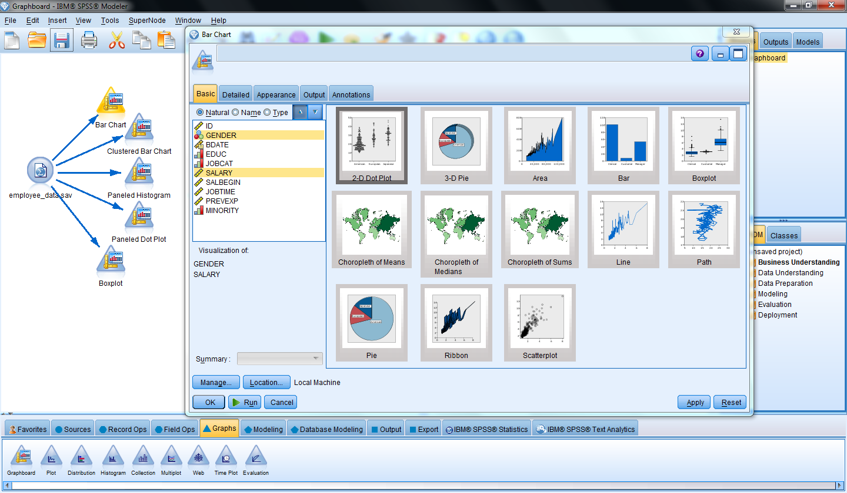
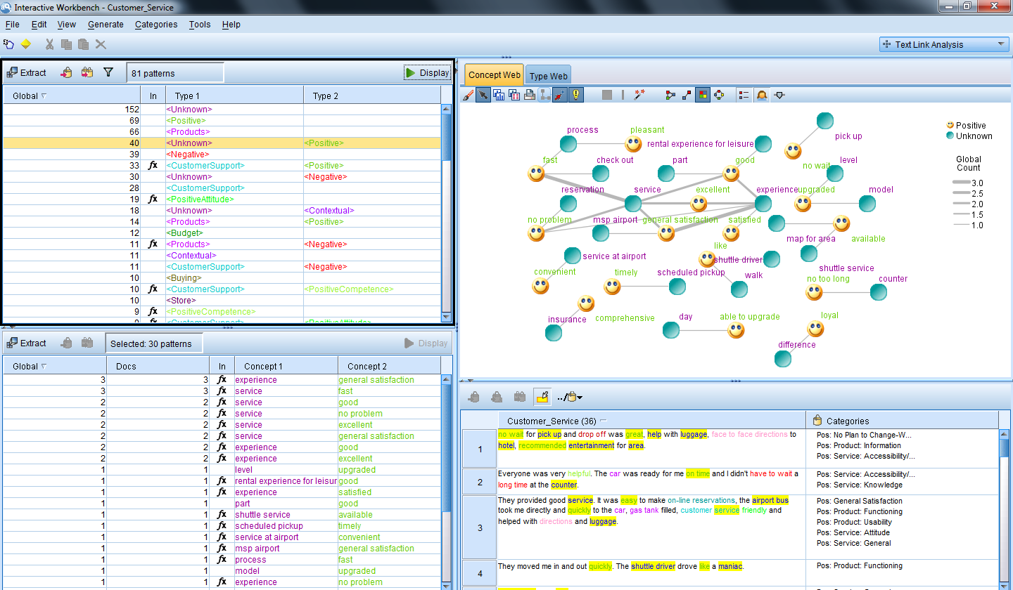
IBM SPSS Modeler
Простота использования, интерактивный интерфейс без необходимости программировать
Автоматизированный выбор наилучших алгоритмов
Доступ к структурированным и неструктирированным данным
Использование встроенных алгоритмов Netezza, Oracle, MS SQL

Slide 17
Показатель ROI у проектов внедрения SPSS
94% клиента SPSS достигли положительный ROI,
средний срок окупаемости 10.7 месяцев
81% проектов SPSS были выполнены по графику, 75% в пределах бюджета
“Это один из самых высоких ROI оценок, которые Nucleus когда-либо видели за всю историю оценок окупаемости проектов”
Rebecca Wettemann, VP of Research, Nucleus Research

Slide 18
Какие задачи решает Data Mining?

Slide 19
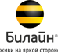




Телекоммуникации
Входящий и исходящий маркетинг
Оптимизация ценового предложения (плана)
Управление лояльностью, прогнозирование оттока
Прогнозирование трафика
Планирование потребления услуг
Оптимизация сетей
Прогноз ценности клиента

Slide 20





Финансовый сектор
Таргетирование маркетинговых кампаний
Кредитный скоринг
Профилирование клиентов – создание новых продуктов
Выявление мошеннических транзакций
Предотвращение оттока клиентов
Cross & up-sell
Анализ страховых выплат

Slide 21



Розничная торговля
Анализ рыночных корзин (чековая аналитика)
Cross & up-sell
Прогнозирование спроса
Таргетированный маркетинг
Оптимизация цены
Управление запасами
Оптимизация размещения на полках

Slide 22
Производство
Прогнозирование обслуживания и ремонтных работ
Оптимизация цепочек поставок
Прогнозирование спроса
Оптимизация склада
Разработка и внесение модификаций в продукты

Slide 23
Кому еще нужен Data Mining?
Транспорт
  Оптимизация расписаний
  Оптимизация маршрутов
Здравоохранение
  Предварительная диагностика
  Прогнозирование взаимного воздействия лекарственных средств
  Рекомендации по оптимальному содержанию клиентов
Гостиничный бизнес
  Ценообразование
  Управление клиентской лояльностью
  Сегментация клиентской базы для формирования целевого предложения
Энергетика
  Прогнозирование ремонтных работ и обслуживания
  Торговля и ценообразование
  Прогнозирование спроса

Slide 24



















Образование

Slide 25
Wichita State University
NA
Achieved 96% accuracy in predicting student academic success
The need:
Wichita State University (WSU), one of six state universities in Kansas, offers more than 140 degree and research programs ranging from undergraduate to doctoral levels. WSU was using outside analysts to score applicants, but the score was a mediocre indicator of ultimate academic success. This made it difficult to plan ahead in terms of recruitment, budgeting and course scheduling. The university wanted to minimize the number of dropped courses and failure rates, which would require a deeper understanding of why students succeed and how best to help them.
The solution:
WSU implemented a suite of IBM SPSS software that analyzed vast amounts of data, including academic records, housing, financial aid and coursework as well as university administration and financial information and uncovered patterns in academic achievement and predicted student performance. This helped the admissions department to target the most promising applicants for enrollment and place them in suitable courses or offer scholarships to increase their chances of success.
Real business results:
Boosted successful admissions by 15 percent.
Achieved 96 percent accuracy in predicting student academic success
Eliminated the need to hire external analysts for application scoring.
Predicted the academic success of a student with 96 percent accuracy.
“Ultimately, business analytics helps our students succeed by matching them closely to the courses that we predict will go well for them, which is healthy for their careers and healthy for our long-term future.”
- David Wright, Assistant Vice-President for Strategic Planning and Business Intelligence, Wichita State University.
Solution components:
IBM SPSS
Notes:
Cross Brand & Smarter Planet Reference
Client Name: Wichita State University
CRDB link: http://w3-01.ibm.com/sales/ssi/cgi-bin/ssialias?infotype=CR&subtype=NA&htmlfid=0GLOS-83WC3S&appname=crmd
Public case study link: http://www-01.ibm.com/software/success/cssdb.nsf/CS/STRD-8NVMCD?OpenDocument&Site=default&cty=en_us
Instrumented - Online course registration, attendance data, faculty and finance systems all feed into the SPSS Statistics Server solution to create a complete record of activity for more than 15,000 students and 2,200 faculty.
Interconnected - The analyst team analyzes the data in SPSS software, which integrates student and course data from student recruitment through degree completion, and joins data from divisional units such as accounts receivable, financial aid, housing and more.
Intelligent - The admissions team can review past data to understand the demographic and academic background of successful students and tailor enrollment and registration campaigns to maximize successful applications. The university can also recommend the most suitable courses and programs for students to avoid dropped or failed classes.

Slide 26

City of Mannheim , Germany
Western Europe
Reduced drop-out rates by 35% by delivering a complete visibility
The need:
Mannheim is a city of 330,000 in southwestern Germany. There are 94 publicly administered schools in Mannheim’s district. To prepare its two-year education report identifying specific issues and needs of the school district, the city’s education department needed a solution capable of collecting, standardizing, analyzing and preparing large volumes of data from multiple official and unofficial sources and databases.
The solution:
Through a sophisticated business analytics solution, a school district has visibility, for the first time, into its education system. The solution gathers and consolidates data across disparate departments and institutions, enabling users to identify potential issues, across the whole education system, that need to be addressed. This allows decision makers to implement appropriate structural and political counteractions based on evidence rather than "gut feeling.“
Real business results:
Expected to reduce the city’s dropout rate by 35 percent
Delivered the ability to generate the department’s two-year education report in hours rather than weeks
Anticipated to increase the number of underprivileged children graduating high school
Identified previously unknown needs in the education system, including a demand for full-time schools and after-school care.
Drove the creation of numerous new programs in infant care, youth work and education counseling
“For the first time, we are able to get a precise, detailed picture of the entire education situation, which is helping us make better decisions on how to allocate resources in a way that will maximize benefits for students – and the community.”
- Dr. Tanja Mangold, education planner, City of Mannheim Education Department
Solution components:
IBM Cognos BI
IBM GBS
Notes:
Smarter Planet Reference
Client Name: City of Mannheim, Germany
CRDB link: http://w3-01.ibm.com/sales/ssi/cgi-bin/ssialias?infotype=CR&subtype=NA&htmlfid=0CRDD-8H4359&appname=crmd
Public Link : http://www-01.ibm.com/software/success/cssdb.nsf/CS/AFRG-8GKJ75?OpenDocument&Site=default&cty=en_us
Instrumented
Comprehensive and systematic collection, interpretation and evaluation of data and information helps to plan and control developments in education. Automatically captures, processes, standardizes and prepares large volumes of data from multiple official and unofficial sources and databases such as the Statistical Office, the registry office, independent data carriers, and the City’s own databases via private and public (Internet) networks.
Interconnected
All data is gathered and (in fixed periods) automatically updated in a huge information pool which is standardized and prepared for comprehensive computing needs. Employees have ad-hoc access to this database. After a basic statistical training, the employees know the essentials about regression analysis, significance tests and calculation of frequencies, percentages and other descriptive analyses. Now it takes just a few clicks for them to obtain the data and statistics they need. All the analyses required for the Cities two-year education report can be produced far faster in comparison with traditional spreadsheets. This report helps the City of Mannheim to determine how close it is to achieving its education policy goals.
Intelligence
The comprehensive analyses are used to build some useful Indicators on different levels of aggregation – for example, pupils, classes, schools, school type, region, etc. Typical education indicators include supervision ratios in child day care centers, numbers of children being enrolled early/late at schools, transition rates from primary schools to different continuing education options, the proportion of school "leavers" without qualifications or the numbers taking up apprenticeship places. Together, these indicators result in a lot of new insights and build the City’s new education monitoring system.

Slide 27
Edinburgh’s Telford College
Western Europe
Improved attendance rates by enabling analysis of attendance problems
The need:
Based in Scotland, Edinburgh’s Telford College provides advanced education and training - primarily focusing on vocational courses and professional development . Class attendance can offer insight into course effectiveness and student issues, as well as help determine financial aid status. The Edinburgh’s Telford College realized the importance of tracking class attendance but lacked the tools to gain the depth of information it needed to assess the academic health of its students and classes.
The solution:
The Edinburgh College tried to analyze the reasons for college students missing classes and wanted to turn attendance information into insight . They implemented IBM Cognos BI that enabled the College to prevent absence-prone students from leaving school. By analyzing attendance numbers in conjunction with student and course information, a new system can alert learning development personnel to students who are missing class and prompt staff to intervene with solutions to possible conflicts and issues.
Real business results:
Improved attendance rates by enabling staff to identify students with attendance problems and intervene to resolve issues.
Increased register completion rate by staff, helping to provide more accurate and complete attendance data for analysis.
Reduced the time it took for staff to receive attendance analysis from weeks to near-real time.
Enabled staff to gain more accurate attendance reports to help in establishing financial aid.
“With its drill-down capabilities, this visual tool has given staff an easier way to identify problems, and clearer cues for intervention. This has contributed to a significant increase in attendance across the college.”
- Lisa Dawson, information services manager, Telford College
Solution components:
IBM Cognos BI
Notes:
Smarter Planet Reference
Client Name: Edinburgh’s Telford College
CRDB link: http://w3-01.ibm.com/sales/ssi/cgi-bin/ssialias?infotype=CR&subtype=NA&htmlfid=0CRDD-8H6PP6&appname=crmd
Public case study link: http://www-01.ibm.com/software/success/cssdb.nsf/CS/STRD-8JYETN?OpenDocument&Site=default&cty=en_us
Instrumented
When lecturers take attendance in class, that data is captured and integrated with information from the school’s student records system, which includes data about individual students and courses.
Interconnected
Web dashboards allow staff members to view information from several metrics across data systems in real time, enabling them to analyze and spot attendance patterns. Dashboards will soon enable students to access personalized timetables that show their attendance status in any course.
Intelligent
Attendance data and information from the student records system are integrated and analyzed against predefined limits. When a student falls below a defined attendance threshold, the system alerts the student and prompts the learning development staff to intervene. As attendance information is integrated with other sources of data such as demographic, financial and course-related information, the college can potentially predict which students are at risk of dropping out and take preventive action.

Slide 28

Hamilton County Department of Education
NA
Enabled a 200% increase in graduation rate by providing critical insights into data
The need:
The Hamilton County Department of Education (HCDE) oversees nine K-12 school districts comprised of 78 schools in and around Chattanooga, Tennessee. HCDE students were consistently scoring below state benchmarks on standardized tests, but the Department of Education lacked the kind of detailed, granular data that would be necessary to understand the factors for the poor performance. Dealing with tough issues like drop out rates and lagging performance required the county to get personal–with a brand new, granular approach supported by predictive analytics.
The solution:
Hamilton County deployed a performance modeling solution using IBM SPSS, that extracts individual student data from the county’s 78 schools and used it to create predictive profiles that can flag students in need of proactive intervention by teachers or counselors. This data is uploaded to Hamilton County’s data warehouse, to track student performance across the educational lifecycle and enabled better understanding of future performance problems.
Real business results:
Directly promoted an 8 percent increase in the graduation rate.
For the Howard School, the solution helped achieve a 200 percent increase in the graduation rate over the last 6 years.
Provided insights that led to improved test scores, with curriculum and teaching changes–as well as a teacher performance incentive program–implemented based on new, reliable metrics.
“Keeping our kids on track academically is an ongoing challenge. We’ve seen a significant payoff from the path we’ve taken, and our aim is to push it even further”
- Dr. Kirk Kelly, Hamilton County Department of Education Director of Accountability and Testing.
Solution components:
IBM SPSS
Notes:
Smarter Planet Reference
Client Name: Hamilton County Department of Education
CRDB link: http://w3-01.ibm.com/sales/ssi/cgi-bin/ssialias?infotype=CR&subtype=NA&htmlfid=0GLOS-87MQKU&appname=crmd
Public case study link: http://www-01.ibm.com/software/success/cssdb.nsf/CS/SSAO-8M4JX8?OpenDocument&Site=default&cty=en_us
Instrumented
Test scores and data on student attendance, behavior and demographics plus data on teacher qualifications and experience - a total of nearly 200 variables - is collected from 78 schools. The analysis is automated, with data compiled and models run overnight on a daily basis. Because the information is integrated into a single dataset, it is possible to track students' performance even if they move from one district to another within the county.
Interconnected
Hamilton County administrators can track students' performance across the entire educational lifecycle, enabling them to better understand the leading indicators of future performance problems. The department merges and analyzes the data to provide teachers with daily profile updates for their students and classrooms. The solution can also provide custom reports, grade-level reports for grant applications and school-level demographic and behavior reports.
Intelligent
Teachers now have deep insight into the needs of individual students and can adjust their teaching style to achieve the best results. The system identifies students who require customized or additional instruction and study time for certain subjects. In addition, by compensating teachers based on their ability to beat data-driven benchmarks, Hamilton County is using predictive analytics to encourage performance improvements for both teachers and students.

Slide 29
Bournemouth University
Western Europe
Reduced workload by more than 8 percent by automating repetitive tasks
The need:
Bournemouth University is one of the best respected academic institutions in southern England. Researchers at Bournemouth University were facing the challenge of creating similar analyses for numerous individual tourist attractions, heritage sites and events. This activity was repetitive and time-consuming and hindered further research.
The solution:
The researchers implemented IBM SPSS to automate several necessary tasks. Some members of the research team also attended highly focused and tailored IBM SPSS predictive analysis training courses to enhance their knowledge on features such as custom tables, syntax and classification trees.
Real business results:
Automated repetitive tasks and reduced workloads by more than 8 percent.
Enhanced analysis, which helped event organizers identify areas for improvement.
By eliminating routine work, analysts were able to focus on more interesting research.
Highly focused and tailored two-day training courses
“Instead of manually creating custom tables to present results for each site, we are now able to set up a table once and reuse it as many times as we like...It’s just a matter of a few mouse-clicks. For repetitive reports such as the one on the 180 heritage sites, this delivers a massive time-saving.”
- Lisa Stuchberry, Research Manager at Bournemouth University.
Solution components:
IBM SPSS
Notes:
Client Name: Bournemouth University
CRDB link: http://w3-01.ibm.com/sales/ssi/cgi-bin/ssialias?infotype=CR&subtype=NA&htmlfid=0CRDD-8HSFQ2&appname=crmd
Public case study link: http://www-01.ibm.com/software/success/cssdb.nsf/CS/STRD-8G2DVQ?OpenDocument&Site=default&cty=en_us

Slide 30

McMaster University
NA
Increased energy efficiency using advanced data modeling techniques
The need:
Founded in 1887 in Toronto, McMaster University is dedicated to Innovation.
Recognizing that buildings are responsible for approximately 40 percent of energy consumption in developed counties. McMaster University wanted to go beyond traditional energy analytics for buildings and gain a more comprehensive understanding of how energy usage could be reduced – and then put that understanding into action.
The solution:
McMaster University, in cooperation with Hamilton Health Sciences, is meeting the challenge – and support LEED® standards for existing buildings – by feeding data from an extensive array of sensors, energy consumption meters and dynamic pricing sources into IBM SPSS and decision-support technology. It can now accurately assess, track, simulate and optimize energy consumption for dozens of buildings. They can also forecast the impact of various energy reduction strategies such as equipment upgrades, temperature management and weatherization, resulting in smarter decisions related to the reduction of energy consumption and greenhouse gas emissions. The university has implemented IBM Cognos to provide the dashboard and reporting for energy-consumption, efficiency and analytic metrics, IBM SPSS to supply energy-efficiency assessment analytics and IBM ILOG to support optimization rules for energy usage and scheduling.
Real business results:
Optimized energy use and scheduling of energy consumption.
Provided the ability to conduct what-if scenarios for estimating the impact of energy-saving initiatives and behaviors.
Created opportunities for reducing the campus’ and hospital's carbon footprint and greenhouse emissions.
“We now have the tools we need not only to monitor real-time energy usage in buildings but also to determine how best to reduce that usage, resulting in lower energy costs and an environmentally friendlier campus.”
- Tony Cupido, AVP Facilities, McMaster University.
Solution components:
IBM SPSS
IBM Cognos
IBM InfoSphere
IBM ILOG
IBM Deep Thunder
IBM DB2
IBM Research
Notes:
Cross Brand & Smarter Planet Reference
Client Name: McMaster University
CRDB link: http://w3-01.ibm.com/sales/ssi/cgi-bin/ssialias?infotype=CR&subtype=NA&htmlfid=0CRDD-8ERP7S&appname=crmd
Public case study link: http://www-01.ibm.com/software/success/cssdb.nsf/CS/CCLE-8H5UAM?OpenDocument&Site=default&cty=en_us
Interconnected:
Collected data is stored in a central database and accessible by research and engineering, facilities management, faculty, and the student population.
Intelligent:
The project is designed to automatically generate information that provides for:
- A web-enabled business intelligent dashboard for analyzing energy consumption, efficiency and greenhouse gas emission
- Web-service-based analytics for computing energy efficiency, greenhouse gas emission rate including: data mining, regression analysis and statistical profiling
- A web-service-based forecasting tool for energy consumption and greenhouse gas emission
- Web-service-based simulation and training tool to provide “what if” capabilities for estimating the impact of energy-saving initiatives and behaviors on energy consumption and greenhouse gas emission
- A web-service-based optimization tool to determine optimal management of energy uses and scheduling of energy consumption activities, taking into consideration energy pricing, peak demand and greenhouse gas emission
- Dashboard to display at building entrances and interactions with the student body.

Slide 31
The Pennsylvania State University
NA
Delivered leading edge software solutions to better prepare students
The need:
The Penn State University offers approximately 160 majors across its 24 campuses throughout the state and a virtual World Campus. A Penn State professor wanted to provide his students with practical quantitative skills that would enable them to better compete in the job market. He looked for software that not only has practical usage in everyday problems but also commonly used in business.
The solution:
The Penn State Professor selected IBM SPSS Software as the statistics solution for his two applied psychology courses. IBM SPSS Software combines both theoretical and practical, so students understand how statistical research is properly applied to everyday problems and questions.
Real business results:
Gave students practical quantitative skills that would help them better compete for jobs.
As IBM SPSS is widely used in business, so students could continue to use the same software in their work life.
The solution was theoretical and practical, so students understood how statistical research is properly applied to everyday problems.
“IBM SPSS Statistics’ menu-driven way of performing analyses makes it simple to transform and compute. The students find the software intuitive, and this makes analysis much easier for them to perform than if they had to learn and write syntax. And with each new version, the software gets easier and easier to use.”
- Dr. Rick Harnish, professor, The Pennsylvania State University
Solution components:
IBM SPSS
Notes:
Client Name : The Pennsylvania State University
CRDB link: http://w3-01.ibm.com/sales/ssi/cgi-bin/ssialias?infotype=CR&subtype=NA&htmlfid=0GLOS-84BD23&appname=crmd
Public case study link: http://www-01.ibm.com/software/success/cssdb.nsf/CS/LWIS-8PLNP6?OpenDocument&Site=default&cty=en_us

